Slide 1
An update from CQC: infection prevention and control
Alison Murray, Head of Adult Social Care Inspection
Dementia and Nursing webinar series
23 September 2020
Notes:
1

Slide 2
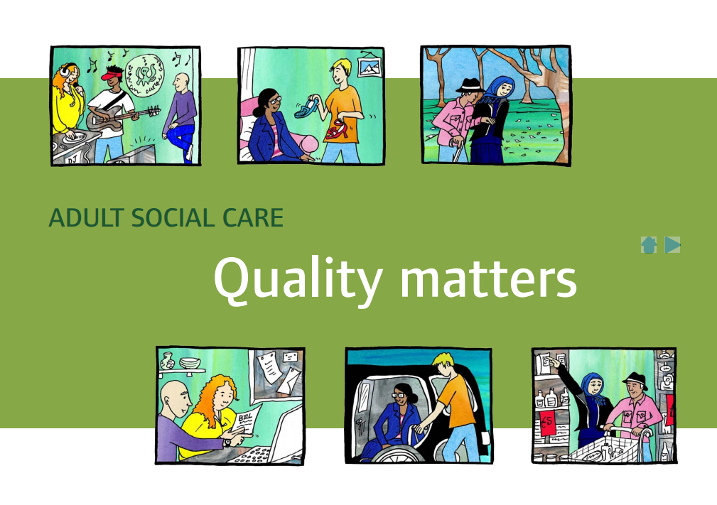
Our role and purpose
The Care Quality Commission is the independent regulator of health and adult social care in England
We make sure health and social care services provide people with safe, effective, compassionate, high-quality care and we encourage care services to improve

Slide 3
CQC and COVID-19
Forced us to adapt how we work so we could support providers, allowing them to focus on the emergency
While routine inspections were paused, we never stopped regulating
Deliver our purpose by:
Gathering and analysing information
Working with providers and partners
Acting on what we know
Developing new monitoring tools
Sharing learning
Notes:
What we did
The COVID-19 pandemic presented a major health crisis that required all health and care bodies, including CQC, to work in very different ways.
During the early stages of the pandemic, we moved quickly to adapt how we regulate and work within the health and care system. We wanted to support providers to keep people safe, allow them to focus on responding to the emergency, avoid our inspectors spreading the virus inadvertently, and reduce demand for scarce personal protective equipment (PPE), so we paused routine inspections.
Still responding to risk
While routine inspections were paused, we never stopped regulating. We continued to inspect in response to risk and concerns; engaging providers and continuing our monitoring activity to support our ongoing assessment of quality and safety, identify risks to the safety of patients and ensure their human rights were protected by:
Gathering and analysing information
Responding to information from frontline health and social care professionals and carers, specifically safeguarding and whistleblowing alerts.
Analysing and responding information from people who use services and their families, which has been supported by our national campaign to increase the level of feedback we gather about the quality of care through our Give Feedback on Your Care service.
Working with providers and partners
Working collaboratively with system partners to support informed decision making and respond to emerging issues at local, regional and national levels.
Having open and honest conversations with providers via our relationship management processes and the Emergency Support Framework (ESF).
Acting on what we know
Undertaking focused responsive inspections where there has been risks to the public.
Using our powers to act against those responsible where we find unsafe or poor care.
Capturing and sharing our findings so we are transparent about the action we have taken, to inform action taken by system partners and government, and to contribute to future recovery and system-wide learning.
Ensuring we consistently reviewed regulatory risk and consistently considered and recorded the final decisions to inspect.
Developing new monitoring tools
To support our monitoring of services we introduced a number of new data collection and monitoring tools.
This included, for example, our Emergency Support Framework (ESF), which supports inspectors to understand where people may be at the greatest risk of unsafe care. The ESF supports structured and consistent conversations between inspectors and providers and enables them to explore the stresses and challenges for care providers and for the wider care system. It is an additional monitoring tool that enables us to explore how services are using innovative ways to manage during the pandemic, so that we can share learning.
To help information gathering in ASC we have also introduced the home care tracker. This tool is designed to complement what is available in the NHS Tracker for adult social care to inform our understanding of some of the risks around the quality of care.
Sharing learning
We have begun, and will continue, to publish a series of insight documents intended to highlight COVID-19 related pressures on the sectors that CQC regulates. It draws on information gathered through our regulatory activity, direct feedback from staff and people receiving care, our new regular data collection from services who provide care for people in their own homes, and insight from our regular conversations with providers and partners.
The information we collect from these sources is being used to understand the wider impact of COVID-19, to share regular updates with local, regional, and national system partners and the Department of Health and Social Care, and to highlight any emerging trends and issues in order to inform the country’s response to COVID-19.

Slide 4
Learning from the COVID-19 crisis
What’s important?
Information sharing
Voice of people
Voice of care providers
Local systems have an impact beyond providers of care, and into the public health and commissioning response – critical to the response of people who use services
Transparency promotes learning – one doesn’t happen without the other
Notes:
Note to speaker - SYSTEMS – there are slides on systems further into the slidedeck so please do mention this when talking to this slide.

Slide 5
How we will regulate during the next phase of the pandemic
The key components are:
A strengthened approach to monitoring, with clear areas of focus based on existing Key Lines of Enquiry (KLOEs), to enable us to continually monitor risk in a service
Use of technology and our local relationships to have better direct contact with people who are using services, their families and staff in services
Inspection activity that is more targeted and focused on where we have concerns, without returning to a routine programme of planned inspections.
We will continue to adapt our transitional regulatory approach, and remain responsive as the situation changes. We’ll also be considering longer-term changes to how we regulate, which we’ll explore through engagement on our future strategy.
https://www.cqc.org.uk/news/stories/joint-statement-cqc%E2%80%99s-chief-inspectors-deputy-chief-inspector-lead-mental-health
Notes:
Joint statement from CQC’s Chief Inspectors, and Deputy Chief Inspector and lead for mental health services
Published:16 September 2020
This statement sets out how we will regulate during the next phase of the coronavirus (COVID-19) pandemic. From 6 October, we will begin to roll out our transitional regulatory approach, starting with adult social care and dental services.
Throughout the pandemic, our regulatory role did not change. Our core purpose of keeping people safe was always driving our decisions. However, as the risks from the pandemic change, we’re evolving our approach in a way that is both sensitive to the changing circumstances of providers, and that also puts people who use services at the centre of what we do.
Our transitional regulatory approach is flexible and builds on what we learned during the height of the pandemic. The key components are:
A strengthened approach to monitoring, with clear areas of focus based on existing Key Lines of Enquiry (KLOEs), to enable us to continually monitor risk in a service
Use of technology and our local relationships to have better direct contact with people who are using services, their families and staff in services
Inspection activity that is more targeted and focused on where we have concerns, without returning to a routine programme of planned inspections.
We will continue to adapt our transitional regulatory approach, and remain responsive as the situation changes. We’ll also be considering longer-term changes to how we regulate, which we’ll explore through engagement on our future strategy.
Developing our monitoring approach
In response to the pandemic, we developed the Emergency Support Framework (ESF) as an additional monitoring tool to support structured and consistent conversations with providers. Combined with other sources of information, the ESF helped us to understand where there were risks of unsafe care, prioritise our support to address this, and share learning from providers that were using innovative ways to manage. The ESF also enabled us to have conversations with NHS trusts specifically about infection prevention and control, to assure us that they had effective plans and processes in place.
Our focus over the last few months has naturally been on the immediate risks from the pandemic. Our transitional approach will build on this work to include looking at more areas where quality needs to improve.
The way we monitor services has been developed through engagement with key stakeholders, providers and the public. Our monitoring will have clear areas of focus, based on our existing KLOEs, specifically targeting safety, people’s access to services, and leadership. We’ll continue to build in other areas of focus.
Using our transitional regulatory approach, our inspectors will monitor and review information from all available sources, collecting further information where necessary. Along with Experts by Experience, they will gather information from people who use services and local groups as part of this, and we’re testing how we can improve this. The experiences of people who use services, their families and carers are central to this approach, and to our future direction as an organisation. To promote this, we’ve launched a year-long campaign with Healthwatch England, voluntary sector partners and others to encourage people to share their experience through our Give Feedback on Care service.
We’ll use a range of information sources to support our monitoring. This includes the work we’re doing as part of our Provider Collaboration Reviews (PCRs), and information gathered through our routine ongoing monitoring. As well as information on individual services, we’ll also use information that we hold about local systems, building on the work as part of the PCRs to understand where there are barriers to good care and to target our activity to help break these down.
This is clear in all our guidance and training for our staff: an inspector’s professional judgement will remain part of how we monitor risk. Our risk model and monitoring activity helps prioritise services where there may be a greater level of risk and helps identify what a proportionate response might be. However, inspection teams will always have the option to act quickly and use their own judgement where other sources of information indicate greater levels of risk elsewhere.
Responding to risk
With the risks relating to COVID-19 still present, we won’t just be returning to business as usual. We’ll draw from the best of our existing methodologies, adapting them to work within the environment we’re in. We are clear that our focus will continue to be on services where we have concerns about care and will continue take appropriate action to protect people if necessary.
The pandemic means that we cannot return to our fixed timetable or frequency rules on inspecting and, given the pressures on providers and the risk of spreading infection, it is unlikely we will return to our published frequency in the near future.
We need to strike a balance between making sure we hear people’s experiences of care and accurately assessing quality while minimising the risk of spread of infection and not adding unnecessary pressure on the health and care system. Where we do carry out on-site inspections, our action will be targeted and driven by the information we hold on a service, focusing on areas where we can’t collect information in other ways, or on services where we need to visit more, for example in secure settings.
On-site inspections are a valuable tool and we will continue to use them proportionately. Where we have information that people are not getting good care, a visit is often the best way to understand what’s really going on.
We are also carrying out pilots in adult social care and general practice. Both will be used to explore new ways of gathering evidence without physically crossing the threshold and be carried out with the explicit consent of the provider. This part of our transitional approach will help us test new ways of working that will inform our future strategy and approach.
Rating providers and reporting on our findings
We know that our ratings and information about our assessments are vital in giving a view of quality in a service.
After a review of the monitoring information and using the streamlined set of KLOEs, we will make a judgement. If we are confident that our review indicates a low level of risk, and there aren’t any risks to people who use the service, then we will take no further action and will let providers know the outcome. Over time our plan is to publish a short statement on the service’s page on our website to let people know. We will also share a summary directly with the provider. Before we do this, we first want to work with people who use services and providers to make sure what we use works for them.
Where the outcome of our monitoring activity leads to us inspecting a service, we’ll use our existing inspection methodologies, and adapt to work with the environment we’re in. This means that across all the health and care sectors we regulate, we can still look at any or all the KLOEs on inspection, to ensure people are receiving safe, high-quality care. However, as our inspections will be more targeted and focused around areas of risk, we may not always cover all aspects of our five key questions and our KLOEs. As a result, our inspections may not always lead to a change in rating for a service.
As well as having limited ability to carry out on-site inspections, our ability to re-rate services is also limited by our published methodologies for rating and reporting on services. Although we’ll be able to re-rate a service in a limited number of cases, this varies in practice between the sectors we regulate. We’ll continue to update you through our Chief Inspectors’ blogs and our updated guidance for providers, so that you know what to expect for your sector.
Finally, we’d like to recognise the dedication and professionalism of everyone working in health and social care. COVID-19 is the biggest challenge to face the health and care system in living memory – and the response from the people who form the backbone of this system has been extraordinary. Thank you.
Kate Terroni, Chief Inspector of Adult Social Care
Ted Baker, Chief Inspector of Hospitals
Rosie Benneyworth, Chief Inspector of Primary Medical Services and Integrated Care
Kevin Cleary, Deputy Chief Inspector and Lead for Mental Health Services
Further information
Rollout for other service types will begin on:
All trusts from 12 October
GP, independent doctors, slimming clinics, urgent care and out-of-hours on 19 October
Further detail on rollout plans for the remaining service types will be released in due course.
Last updated:16 September 2020

Slide 6
Sharing insight – reports from CQC
Monthly insight reports intended to highlight COVID-19 related pressures on the sectors that CQC regulates
Drawn from:
direct feedback from staff and people receiving care
data collection from services who provide care for people in their own homes
insight from our regular conversations with providers and partners
Issue 4 published
www.cqc.org.uk/covid19insight

Slide 7
Issue 4: Infection Prevention and Control (IPC)
300 care homes inspected in August to look for best practice where services have managed well, including services with an outbreak and those which remained COVID-free:
Very few not managing
More than 90% assurance across all elements
Full report in November
Many examples of good practice
www.cqc.org.uk/covid19insight
Notes:
During August, we carried out a special programme of inspections of infection prevention and control (IPC) in 300 care homes selected as potential examples of where IPC was being done well. We have been encouraged by the findings so far:
Very few of these services turned out not to be managing well and requiring a fuller inspection.
Across the 300 inspections, we’ve had more than 90% assurance across all the elements we were looking at.

Slide 8
Examples of good practice
Feedback from the initial inspections has identified good practice examples, such as these:
“Staff had organised an Eid dinner via [video conference] for a person who had always shared this with their family. Staff decorated the room and played the video link through a large television. The manager told us this made the person feel they were sitting at the table with their family.”
Staff have produced a brochure for families and friends called 'We've missed you'. This details the different ways people can stay in touch, how to arrange it and what guidance they need to be aware of.
The manager introduced a covid quiz which tested staff knowledge and understanding of good PPE practice. This was strengthened by some games in team sessions, for example who could don and doff PPE the fastest. This reinforced processes in a light hearted but effective way.
We will report fully on the findings of this programme in November.

Slide 9
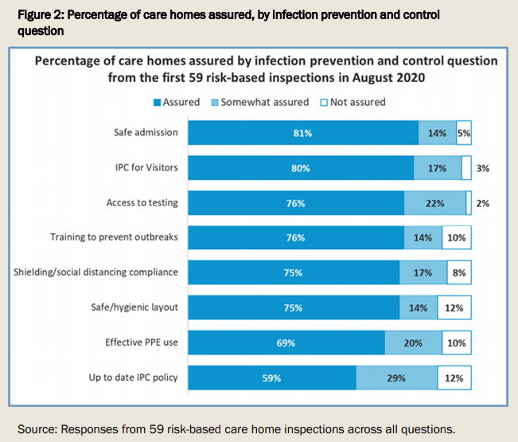
Issue 4: Infection Prevention and Control (IPC)
59 inspections in high-risk care homes:
Assured or somewhat assured in most cases
www.cqc.org.uk/covid19insight
Notes:
59 high-risk inspections of care homes during the first half of August 2020.
These were inspections carried out specifically in response to concerns about safety and quality, or to feedback from staff or people using services and their families.
During these inspections we reviewed how well staff and people living in care homes are protected by IPC, looking at assurance overall and across eight key areas.
Despite these being services where we may have had concerns about quality, we were assured or somewhat assured in all areas of good IPC in the majority of services (see graph). The findings allow us to review the two areas where we had greatest assurance – in safe admission and IPC for visitors, as well as the two areas where we had least assurance – IPC policy and effective use of PPE. This highlights areas of relative strength, as well as the gaps and barriers most commonly missed by services, which providers can use to reflect on and improve their practice.

Slide 10
Issue 4: Infection Prevention and Control (IPC)
Much good practice to be celebrated on safety, enabling safe family visits with good IPC with creativity and flexibility from homes
But…
Lowest level of assurance (58%) for having up to date IPC policies – some were updated at the start of the pandemic and not since, others not at all since 2019
Some homes had no specific BAME risk assessments or hadn’t planned ahead for winter
68% of the 59 homes used PPE effectively – one home was not changing masks, some were inconsistent or PPE was locked away, others stored PPE uncovered or did not dispose of it correctly.
www.cqc.org.uk/covid19insight
Notes:
Safe admission
We were assured in more than four-fifths of care homes in our risk-based inspections that the homes were following the guidance in relation to safe admissions. This included carrying out tests to make sure they knew people’s COVID-19 status. Some care homes would only accept people from hospital with a negative test. Others had procedures in place to safely accommodate people while they awaited test results. This required the person to be cared for in isolation until a negative test was obtained, by allocated staff who always wore appropriate PPE.
“Current measures in place are person is escorted to their bedroom – set up a PPE station outside their room – clothes are labelled so they are left for 72 hours. Staff will be in full PPE.”
Examples were provided to demonstrate how all new admissions had isolated for 14 days, including those returning from a hospital visit. Care homes carried out routine monitoring throughout the isolation period. Other homes routinely monitored all the people who lived there and had procedures in place should they identify concerns.
A few services had a ‘no new admissions’ policy in place.
There was some evidence to suggest services had considered the Mental Capacity Act, Deprivation of Liberty Safeguards and best interest decisions around COVID-19 and isolation for those who lacked capacity.
IPC for visitors
We were assured in around four-fifths of care homes in our risk-based inspections that all types of visitors were prevented from catching and spreading infection.
Care homes’ approaches to visiting should be appropriate for the service and consider and meet the needs of people living in them. Care homes we inspected had different visiting policies, ranging from a few that still had a ‘no visitors’ policy, those that were facilitating window or garden visits, through to a few that were now allowing essential visitors into the home. Inspectors were assured, however, that the different approaches taken by these homes were appropriate for the service and the people living in it, and managed well.
“For one person with a learning disability there are special arrangements for a relative to visit, which greatly relieves his anxiety. A special room is set aside for them and PPE is worn at all times.”
Where no visitors were allowed into the home, there was usually an exception for people receiving end of life care.
When visitors entered a care home there were often screening procedures in place, such as a questionnaire or declaration and temperature checks. PPE was required and, in most cases, provided if the visitor did not have their own. Handwashing facilities and hand sanitiser were available, and their use prompted by staff. Inspectors saw good signage at the entrance to care homes and reminders throughout the home.
It was most common for visits to be supported in the garden, which could be accessed without entering the care home. If the weather was poor some services had identified indoor spaces, which again could be accessed without entering the main body of the home. Visitors were required to wear face masks and maintain a safe social distance. Contact with staff members was limited.
Some care homes allowed visits only at open windows, by appointment to avoid crowding. Another service allowed relatives to come in their car and see their relative or friend through the open car window. Care homes had written to families to explain their visiting policy and the majority had alternatives to face-to-face visiting. Inspectors described how people living in the care home were supported to contact their relatives and friends by video.
“Provider had offered [app] to people using services’ families free of charge during COVID-19… to keep them up to speed with their relative’s care, daily activities and wellbeing. Staff take photos and videos of the person and send them to families, who can respond back. The home also bought two portals to facilitate visual, real-time interaction between people using services and their families.”
Visits tended to be by appointment only, restricted to one visitor at a time and staggered to allow cleaning between visits. Inspectors were assured by seeing the policy in action.
IPC policy
We found the lowest level of assurance (58%) against the question, “Is your IPC policy up-to-date and implemented effectively to prevent and control infection?”. Inspectors reviewed each care home’s policy and interviewed staff to understand whether it had been implemented effectively. We found examples of IPC policies that were out-of-date. Some had been updated early on in the COVID-19 outbreak but had not been amended since and so contained out-of-date information. This posed a risk to the staff and people who live in the care home. Others had not been updated since 2019.
Another barrier to effective infection prevention control was limited, or a lack of, contingency planning. One care home had completed a plan, but it only covered the hot weather and did not include preparations for autumn and winter.
We also found examples of care homes that lacked risk assessments for people from Black and minority ethnic groups and others who were at higher risk due to the pandemic, as well as for staff members. Our inspectors also found that risk assessments for these groups had not been actioned.
Effective use of PPE
The second lowest area of assurance in these risk-based inspections (68%) was whether services used personal protective equipment (PPE) effectively to safeguard staff and people using services. In care homes where PPE was not worn at all or not worn correctly, IPC was compromised. This was seen in different areas of the homes, such as during break times, while handling or serving food, and when in close proximity with the people they provided care for. There were instances where it was only one member of staff who was not using PPE correctly, through to no consistency with its use among different staff members.
In one service we found staff were not changing masks due to limited supplies. They said that PPE supplies were restricted and they had to request supplies throughout the shift because they were locked away, with only the manager and lead domestic having access.
PPE should be stored safely in a clean, dry area to prevent contamination¹. We observed care homes that lacked a specific area for donning and doffing PPE, which could lead to contamination of other surfaces, and PPE that was stored uncovered.
“There are no specific donning and doffing stations. Staff use the staff toilet to do this, or don and doff in corridors where the aprons and gloves are kept, and not always covered to prevent cross infection. Observed aprons hanging over towel rails – not covered. Saw much of the PPE not covered.”
Another barrier to effective infection prevention control was PPE that was not disposed of correctly as healthcare waste. We also found that appropriate bags for the disposal of used PPE were not always available. Inspectors saw PPE in regular waste bins that had not been sealed and bagged separately.

Slide 11
Issue 4: Infection Prevention and Control (IPC)
We can and will take regulatory action where we have concerns over a small number of services not tackling IPC correctly
We have seen some great practice in early inspections
It is vital that all providers get this right owing to rising infections
The questions and prompts inspectors use to look at how well staff and people living in care homes are protected by infection prevention and control (IPC) are available on our website
Infection prevention and control in care homes | Care Quality Commission
www.cqc.org.uk/covid19insight

Slide 12
Learning lessons: future of adult social care
People focus
Inequalities in the system reflected in the outcomes for people receiving care
Partnership
Local systems have an impact beyond providers of care, and into the public health and commissioning response
Pathways
Changing access and boundaries directly impacts on care
Notes:
Main lessons to be learned – 3 points
Firstly People – what has all of this meant for people in our services? in addition to the overall death toll it has highlighted inequalities in the system. Are we properly recognising the diverse needs of people? We must rise to the challenge and think honestly about how we respond to BAME people in our services, those with a learning disability, those with complex and challenging behaviour and how their diverse needs can be comprehensively met.
Also shown that the move towards a more directive model, with centralised policies and procedures - when we rightly focus on keeping people safe - can lead to a one size fits all approach where people lose those things that matter most to them. The essential choices within care and the respect of people’s human rights needs even closer attention and becomes a careful balancing act. The Think Local Act Personal – making it real statements are more important than ever.
Partnership - COVID has shown the health and social care system needs to recognise the equal worth of each part, that we can only achieve a safe and comprehensive health and social care service that meets people’s needs by working together. This partnership working must have a system focus beyond traditional boundaries - reaching into public health and encompassing a focus on commissioning innovative services. The move from Competition to Collaboration seen during Covid, across health and social care and within it, needs to be expanded and maintained.
Pathways – COVID clearly illustrated what happens when pathways are disrupted. Access to health services in the community and hospital services has had significant impact on people using ASC. We need to make sure pathways are responsive and secure for people – across every local area.

Slide 13
COVID-19 Provider Collaboration Reviews (PCRs)
Why? To understand how providers have worked collaboratively to meet the challenges posed by the COVID-19 pandemic
What are the objectives of this work?
Support providers by sharing learning from COVID-19 and how providers are preparing to re-establish services and pathways locally
Understand the experiences of people who use services, their families and their carers
To share with DHSC, providers, local and national stakeholders ahead of any potential ‘second wave’ of the virus, and winter’s pressures
Further develop CQC’s insight reporting
Notes:
COVID-19 PROVIDER COLLABORATION REVIEWS (PCRs) LAUNCHED 8 JULY 2020
Why?
The speed and scale of the response required by the COVID-19 pandemic has highlighted how any fragmentation in our current health and care systems significantly impairs the country’s ability to respond effectively. The reviews include understanding the journey for people with/without COVID-19 across health and social care providers, including the independent sector, as well as council and NHS providers.
What are the objectives of this work?
Support providers by sharing learning from the COVID-19 period and how providers are preparing the re-establish services and pathways locally
Understand the experiences of people who use services, their families and their carers
To share this learning with DHSC, providers, local and national stakeholders ahead of any potential ‘second wave’ of the virus, and next winter’s pressures
Further develop CQC’s insight to evolve our data offer to stakeholders and inform our understanding and reporting of the impact of COVID-19 on a regular basis
Should CQC review health and social care systems as part of our business as usual approach in the future?

Slide 14
COVID-19 Provider Collaboration Reviews (PCRs)
Full findings later this autumn. So far, we can see:
Understanding local population needs, including cultural differences, was especially important.
The quality of existing relationships between local providers played a major role joined up health and social care
increased focus on shared planning and system wide governance, but pre-existing plans may not have been fit for purpose to cope with COVID-19
Staff across health and social care worked above and beyond - we spoke to dedicated, passionate staff
Range of initiatives to ensure the safety and wellbeing of staff
Notes:
So far, we can see:
Understanding local population needs, including cultural differences, was especially important.
The quality of existing relationships between local providers played a major role in the coordination and delivery of joined up health and social care services that meet the needs of the local population.
There was an increased focus on shared planning and system wide governance, but pre-existing plans may not have been fit for purpose to cope with COVID-19.
Staff across health and social care worked above and beyond their roles - we spoke to dedicated, passionate staff, committed to supporting everyone including people aged 65 and over.
There was a range of initiatives to ensure the safety and wellbeing of staff working both on the front line and in support services.
The move to digital working accelerated and impacted on access to services, and more generally digital solutions supported data-sharing and communication between health

Slide 15
Now, next, future
Now
Focusing on higher risk services: Emergency Support Framework (ESF)
Preparing for future system pressures: Provider Collaboration Reviews
Next
Moving beyond emergency: Transitional regulatory approach (Sept 2020)
Future
Creating our future: Future strategy development and transforming how we work (our operating model) to deliver it.
(to May 2021 and beyond)
Notes:
NOW
We’re continuing to focus on higher risk services using the Emergency Support Framework (ESF) we developed during the pandemic. Thanks to our enhanced digital capabilities, this way of monitoring has worked well for us, combined with inspecting when we need to.
We’re also completing our series of 11 Provider Collaboration Reviews (PCRs) – you’ll remember Carolyn Jenkinson, Head of Inspection, Hospitals, and Natalie Reed, ASC Inspection Manager updated on this work in the all-colleague calls a few weeks ago. These reviews are shining a light on where collaboration has worked well across the system, helping to drive improvements and prepare for future pressures on local care systems. Our next series of PCRs are currently being planned and what we learn from these will be built into our future strategy and ways of working.
NEXT
We’re developing a transitional regulatory approach to start from September 2020
We’ll build on the emergency approach we used during the pandemic to evolve to the changing circumstances of providers, widening our focus.
We’ll move beyond prioritising immediate risks, as we have done during the pandemic, to a wider view of services and where care needs to be improved.
We’ll target our assessments to look at the most important areas of quality – safety, access and leadership.
We’re following the approach we used with ESF and 60 super users will support our implementation and training plan. Sector leads will also help colleagues stay in touch with developments and provide feedback.
What we learn from using this approach will be built into our future strategy and ways of working.
More detail on approach:
We’ll use the increasing amount of information we have about the health and care system (e.g. through our PCRs) to help target our activity at a service level.
We’ll balance the time needed on site to speak to people, with the need to ensure infection control. To balance this effectively we’ll be piloting new ways of gathering data and information without crossing the threshold in each of the sectors.
We’ll trial new ways to gather increased information about people’s experiences of care – this will be at the heart of our transitional approach and in our future strategy.
We’ll continue to re-rate a number of providers in a limited number of cases using our existing methodology for targeted and focused inspections.
FUTURE
We’re continuing to develop our future strategy to start from May 2021, testing and iterating as we go, building in feedback from colleagues, people who use services, providers and members of the public at every stage.
Alongside this we are transforming how we work and developing a new operating model that will help us deliver our strategy effectively, and drive us forward into the future.
The rest of this pack is focused on the work we are doing on our strategy and operating model to create a future CQC we can all be proud of.

Slide 16
Staying up to date
Provider Bulletin
Changed from weekly to fortnightly with a coronavirus (COVID-19) focus. Sign up here: https://www.cqc.org.uk/news/newsletters-alerts/email-newsletters-cqc
CQC Twitter account
For the most up to date, immediate information
Follow: @CQCProf
Get involved on our digital platform
Feedback surveys available on each theme
Sign up here: https://cqc.citizenlab.co/en-GB/

Slide 17
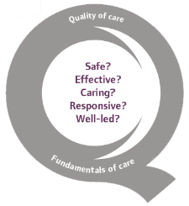
Thank you
www.cqc.org.uk
enquiries@cqc.org.uk
@CQCProf
Alison Murray
Head of Adult Social Care Inspection
17
Notes:
“We are in discussions with the Department of Health and Social Care about their Winter Care Plan to ensure safe, high quality care and support providers as we approach the winter months.”

